Slide 1
Code Reviews

Slide 2
Code review processes
  Gerrit
    Refactoring, new contributions
  Comprehensive code reviews
    Review of all the code in the toolkit

Slide 3
Each ITKv4 contractor agreed at the Bethesda meeting to review a portion of the toolkit…
Portion of the toolkit to review is proportional to percentage of the ITKv4 funding the contractor received.
System of “shares”
    Kitware – 2 shares
    GE – 2 shares
    UPenn – 2 shares
    Harvard – 1 share
    Cosmo – 1 share
    Iowa – 1 share
A2D2 contractors exempt.

Slide 4
Goals are to identify, record, and sometimes remediate
Organization issues
  Is a class in the right place?
Documentation issues
  Is the class documented sufficiently?
  Are the methods documented sufficiently?
Design issues
  Does a class do the right thing?
Duplication issues
  Are there several classes that do the same thing?
Architecture issues
  Does a class do things right?
API issues
  Is the API complete? Does the API follow ITK conventions?

Slide 5
Expectations are to “handle” every file
Every file will be reviewed
All identified issues will be recorded
Issues which are easy to fix will be fixed by the reviewer
Issues that are very involved or outside the reviewers expertise may be deferred
Limited resources
Best person to remediate
All reasonable effort will be exerted to maintain backward compatibility

Slide 6
Process
Spreadsheets
  Tab by module, tab by contractor
  Columns to checkoff, make notes on issues.
Report
  Text file for each class
  Git repository with a directory hierarchy that mirrors ITKv4
    git clone git@github.com:InsightSoftwareConsortium/itk-retroactive-review.git

Slide 7
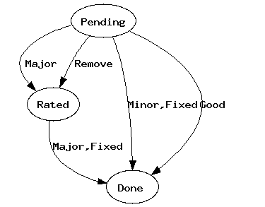
Process
http://www.itk.org/Wiki/ITK_Release_4/Modularization/Code_Reviews/Process
Review Status
  Pending
  Rated
  Done
Rating
  Good
  Minor
  Major
  Remove

Slide 8
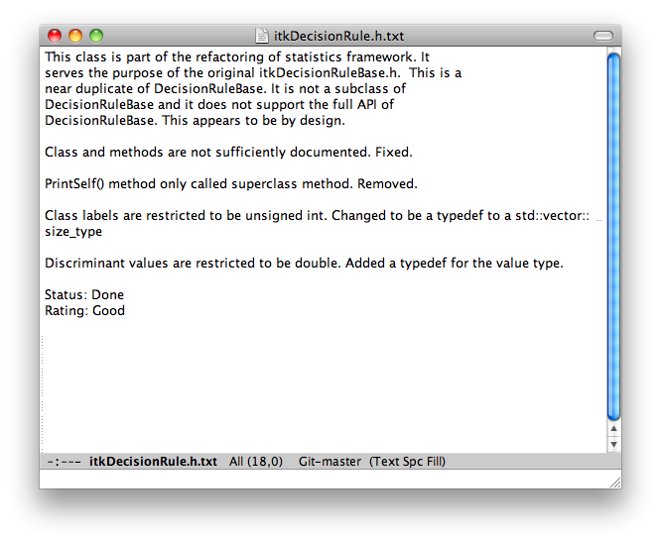
Example

Slide 9
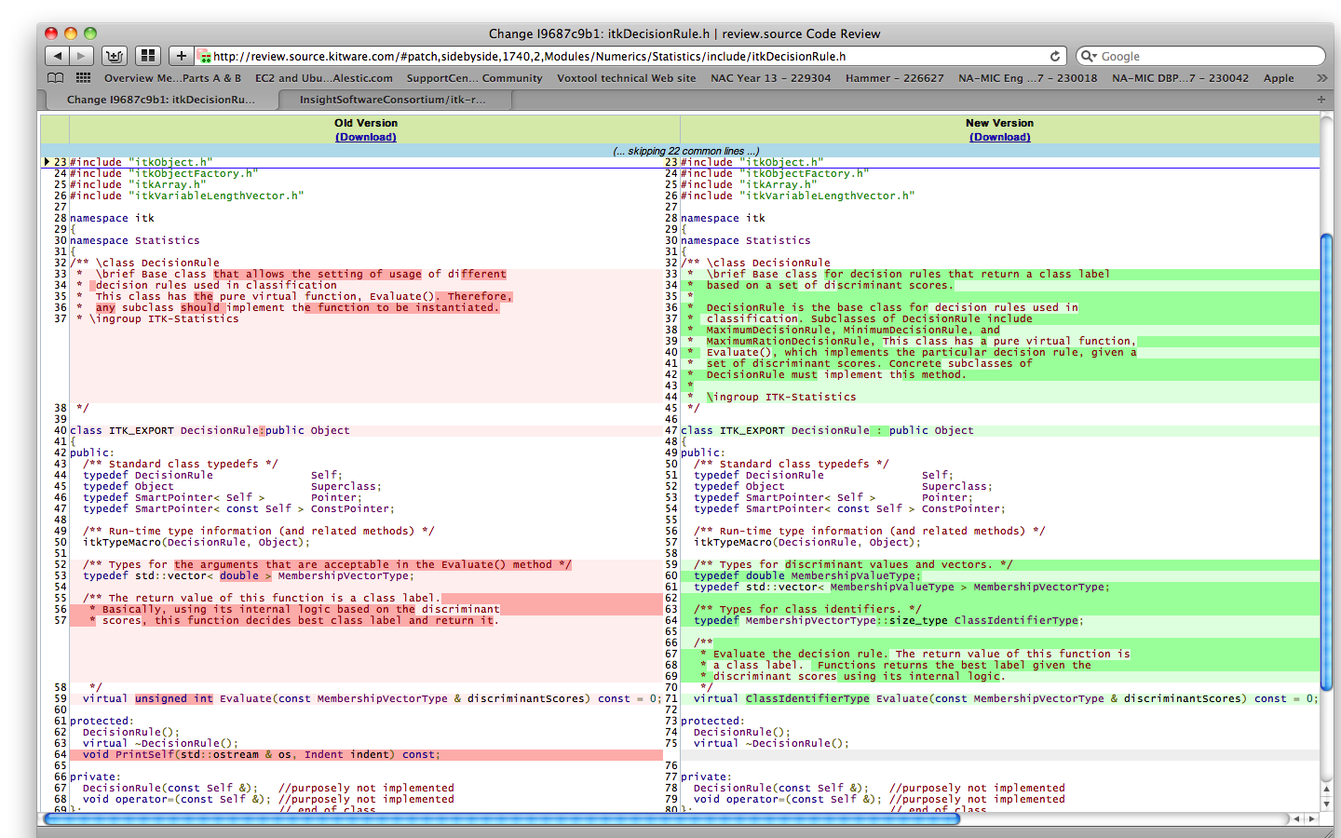
Example

Slide 10
Status
1537 .h files, 201 reviewed, 14 done, 40 major, 104 minor, 4 remove
938 .txx files, 139 reviewed, 3 done, 16 major, 20 minor
286 .cxx files, 22 reviewed, 6 done, 0 major, 4 minor

